Slide 1
Addressing customer complaints

Slide 2
When it comes down to it, many customers don't even bother to complain. They simply leave and buy from your competitors.
Research suggests that up to 80
percent of customers who leave
were, in fact, "satisfied" with the
original company. Obviously,
customer satisfaction is not enough. Businesses nowadays need to positively delight customers if they want to earn their loyalty.

Slide 3
It may seem counter-intuitive, but a business owner’s ability to effectively deal with customer complaints provides a great opportunity to turn dissatisfied customers into active promoters of the business. Here are some customer-oriented tips I’ve learned while working in the business coaching business:
Listen carefully to what the customer has to say and let them finish. Don't get defensive. The customer is not attacking you personally; he or she has a problem and is upset. Repeat back what you are hearing to show that you have listened.

Slide 4
Ask questions in a caring and concerned manner.
The more information you can get from the customer, the better you will understand his or her perspective. I’ve learned it’s easier to ask questions than to jump to conclusions.

Slide 5
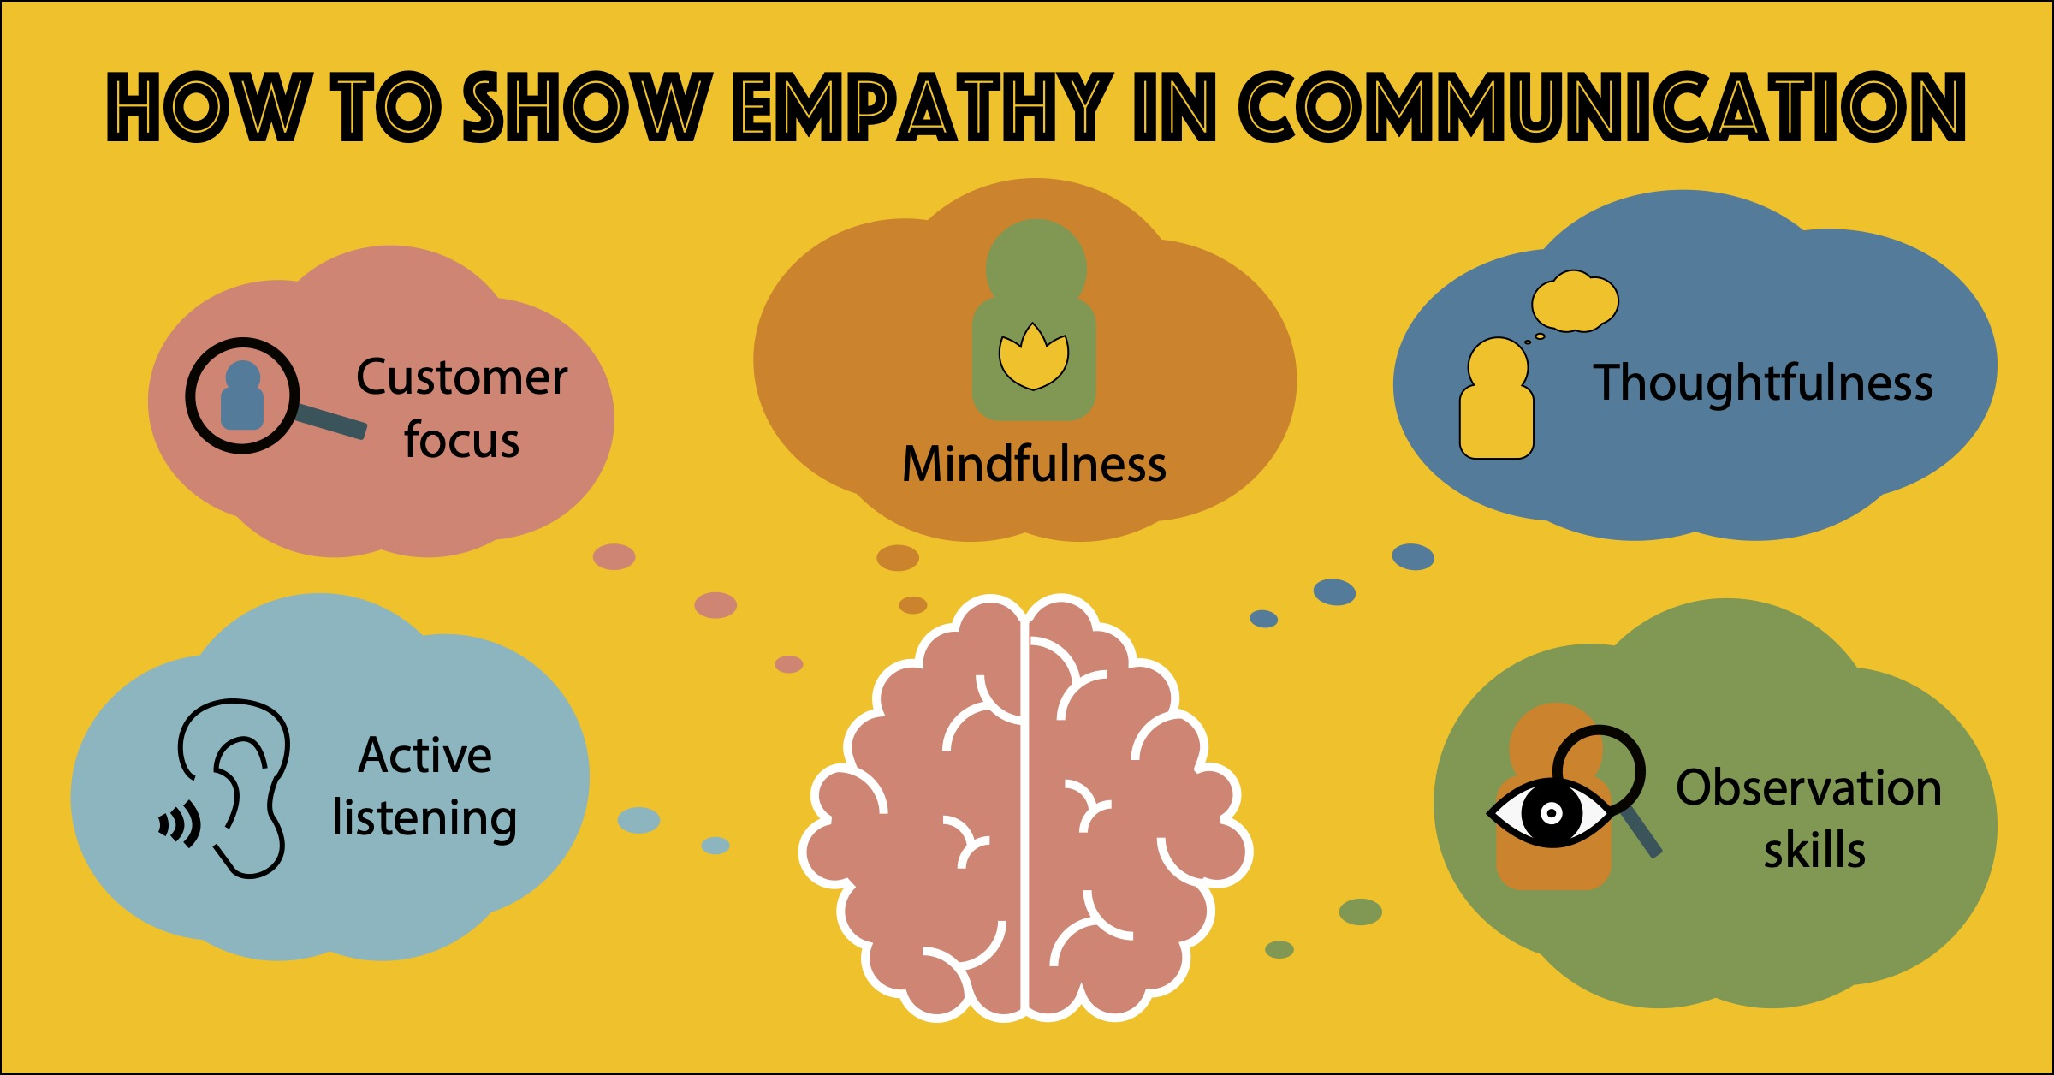
Put yourself in their shoes.
As a business owner, your goal is to solve the problem, not argue. The customer needs to feel like you’re on his or her side and that you empathize with the situation.

Slide 6
Apologize without blaming.
When a customer senses that you are sincerely sorry, it usually diffuses the situation. Don't blame another person or department. Just say, "I'm sorry about that.”

Slide 7
Ask the customer, "What would be an acceptable solution to you?"
Whether or not the customer knows what a good solution would be, I’ve found it’s best to propose one or more solutions to alleviate his or her pain. Become a partner with the customer in solving the problem.

Slide 8
Solve the problem or find someone who can solve it— quickly!
Research indicates that customers prefer the person they are speaking with to instantly solve their problem. When complaints are moved up the chain of command, they become more expensive to handle and only add to the customer's frustration.

