Slide 1
Customer Service
Get to Know your Customer

Slide 2
Greet Your Customers in a Winning Way
Acknowledge the customer’s presence
Within the first 10 seconds
If customer waits 30-40 seconds, feels like 3-4 minutes
First impression is hard to change
Make eye contact
If working with customer and new one walks in excuse yourself briefly to tell the new customer you will be right with them.

Slide 3
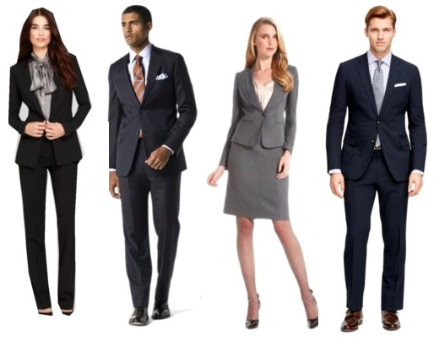
Greet Your Customers in a Winning Way
Project a professional and friendly image
Dress professional
Act alert & courteous
Sincere and interested in customer
Smile with eyes and mouth

Slide 4
Greet Your Customers in a Winning Way
Create an opening for discussion
Don’t ask closed ended questions like “May I help you?” You will get a response like, “No thank you” or “I’m just looking.”
Only appropriate comments

Slide 5
Greet Your Customers in a Winning Way
Be reassuring, but not pushy
It’s what you say and how you say it.
Don’t push humor too far.
Be sincere and honest when telling a customer they look nice
Positive impression created by:
Complementing the customer’s taste
Assuring the customer he’s the expert
Showing your own knowledge of purchases that are worthwhile

Slide 6
Greet Your Customers in a Winning Way
Include the entire shopping party
Offer customer’s friend a chair to sit while waiting
Offer kids a toy for mom to finish shopping (Always ask permission from parents first!)
Don’t interfere with parent reprimanding child or couple arguing over a purchase
***create customer loyalty: bring the customer back to the store!
***build trust: by responding to their needs and given information needed
***tip: 45% of customers say they are likely to spend more if the sales associate is helpful. 18% of customers will walk out of store if they don’t like the attitude of sales associate

Slide 7
Be Observant
If the customer is in a hurry you should give quick & efficient service.
If the customer is browsing- offer service but give space to browse
If the customer is checking price tags-make them aware of specials
If the customer is scanning the area looking for merchandise-give directions
If the customer is looking for/at a clock they might be in a hurry, “I’ll assist you in finding the item.”
Difficulty deciding between items-ask questions to see why customer can’t decide, then offer additional info

Slide 8
Determine a Customer’s Needs
Customer’s desire for a product or service can be conscious or subconscious
They either know exactly what they want or only have a general idea
Help with unspoken needs like explaining the warranty (extended product feature)
Observe and Ask Questions
Know the questions to ask to figure out wants, needs and buying motives
Open ended questions:
Who, what, when, where, how, why
What is the special occasion?
Who are you shopping for?

Slide 9
Keep the Lines of Communication Open
Know the questions not to ask
Avoid directly asking customer how much they want to spend
You will need to know a price range so you don’t waste their time with too expensive items
Examples of good questions to ask include:
“What clothing lines do you usually prefer?”
“What brand fridge do you have at home?”
Avoid questions that force customers to choose options before they have reviewed them
After you’ve asked a question, make sure you listen to the customer’s answer
Show interest by saying, “I know where you’re coming from.” Or “I understand.”
Know the products’ price, brand, color, size which helps meet the customer’s need

Slide 10
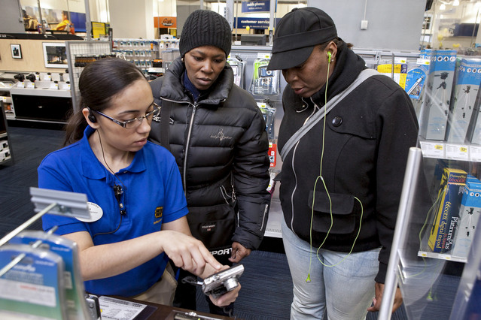
Fit the Products to the Customer
Find the right fit regardless of product or service involved
Sometimes “fit” can be a sensitive issue – be careful.
Never react to a customer after asking what size
Take cues (hints) from customer to find out size.
You can ask, “Have you ever worn this brand before? What size fit the best?”
Bring several sizes out because brands can vary in size

Slide 11
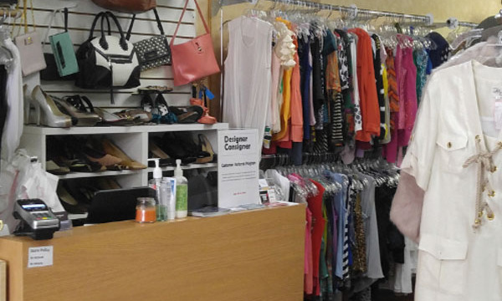
Fit the Products to the Customer
Don’t judge a person or say anything about sizes being too small.
Service Extras-they may need a different size:
Special-order merchandise
Customizing
Alterations
Accessories

Slide 12
Offer Alternatives
Offer alternatives if you don’t have what the customer wants (ask permission)
Different color
Comparable brand
Similar model
After the customer agrees to see alternatives they will either:
Best case- they like the alternative – make purchase
Worst case- customer feels you tried to help them
Don’t spoil the customer‘s experience with the hard sell technique.

Slide 13
Offer Alternatives
If you do not have what the customer wants, or an alternative, or you can’t special order it then the last choice is to send them to a competitor.
Call the competitor to see if they have it and give the customer directions.
If you work in a large store and you do not carry an item in your department walk the customer to the department that does have the item

